Slide 1



Slide 2

What is version control?
Version control, also known as source control, is the practice of tracking and managing changes to software code.
Version control systems are software tools that help software teams manage changes to source code over time.

Slide 3
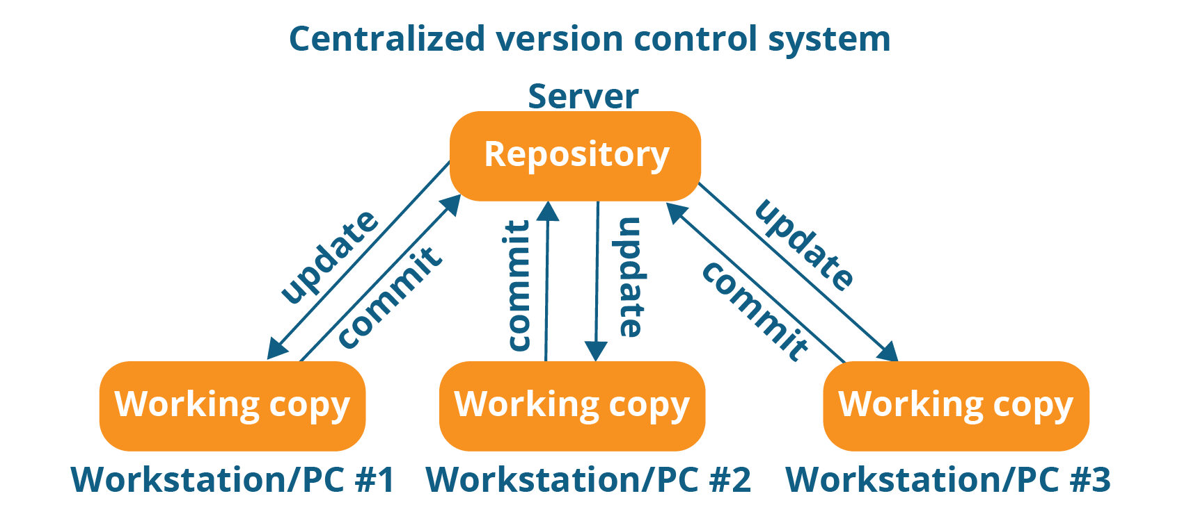
Version control system

Slide 4
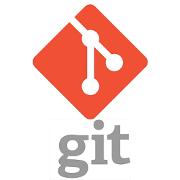
What is Git?
Git is the most commonly used Distributed Version Control System (VCS).
Git tracks the changes you make to files, so you have a record
of what has been done, and you can revert to specific versions
should you ever need to.
Git also makes collaboration easier, allowing changes by
multiple people to all be merged into one source.

Slide 5
Why use Git?
Open source
Save Time
Undo Mistakes
Make Useful Commits
Work in Your Own Way
Collaborate & Contribute

Slide 6
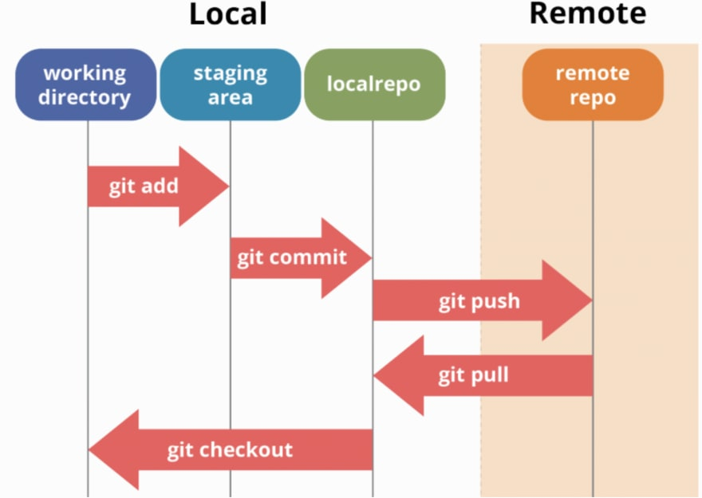
Workflow

Slide 7
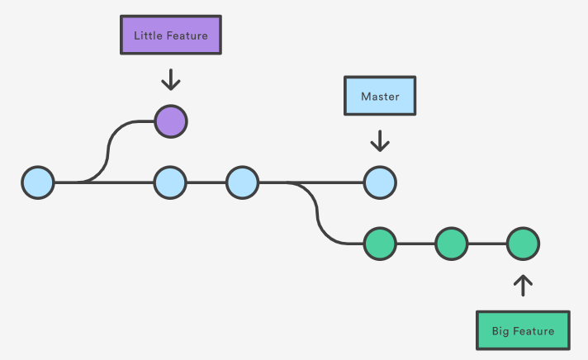
Branching

Slide 8
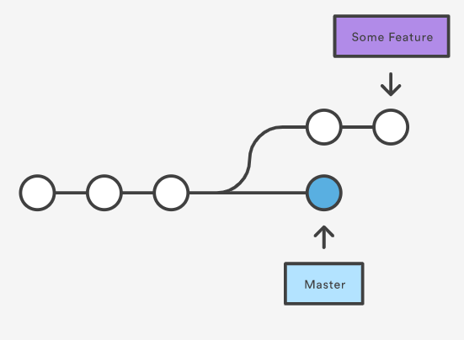
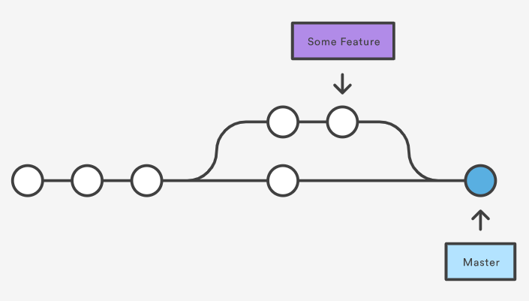
Merging

Slide 9
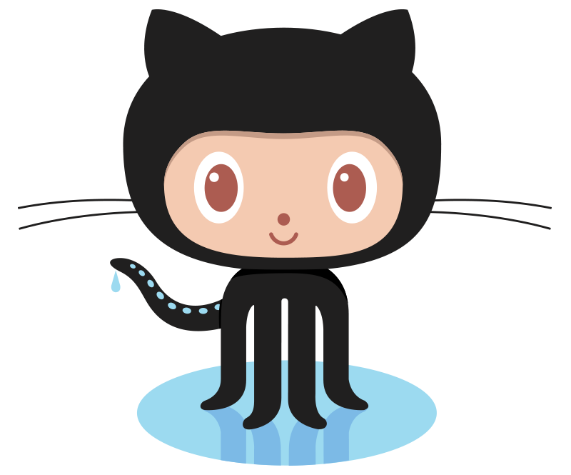
What is GitHub?
A code hosting platform
Easy Version Control
Easy to Collaborate with others
Open Source Development
Bug Tracking, Automation, Project Boards

Slide 10
GitHub Features
GitHub User Interface (UI)
GitHub Gist
GitHub README files (written in Markdown)
GitHub Project Boards

Slide 11
GitHub Features
Forking and Cloning remote Repos
Contributing to Open Source
Creating Issues
Pull Requests (PR)
GitHub Pages (Static Website Hosting)

Slide 12
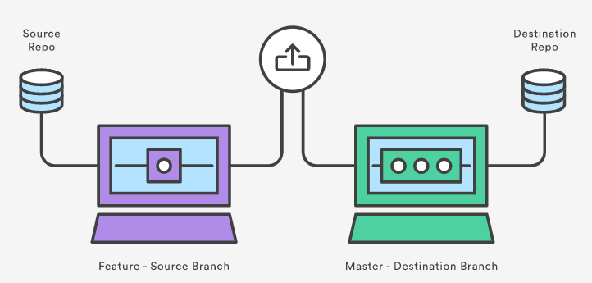
Pull Requests

